Slide 1






Linux Operating System

Slide 2

TABLE OF CONTENTS
01
Linux Variations
04
Activity
02
Terminal & Command Line
05
Quiz
03
System Updates
06
More Resources

Slide 3
Linux
Variations

Slide 4









Linux Variations
Linux has different operating system variations, called distributions, that you can choose from based on your preferences and experience. Some popular distributions are Ubuntu, Mint, Red Hat, and Fedora. For Cyber Patriot, you will be using Ubuntu.

Slide 5
Terminal & Command Line

Slide 6
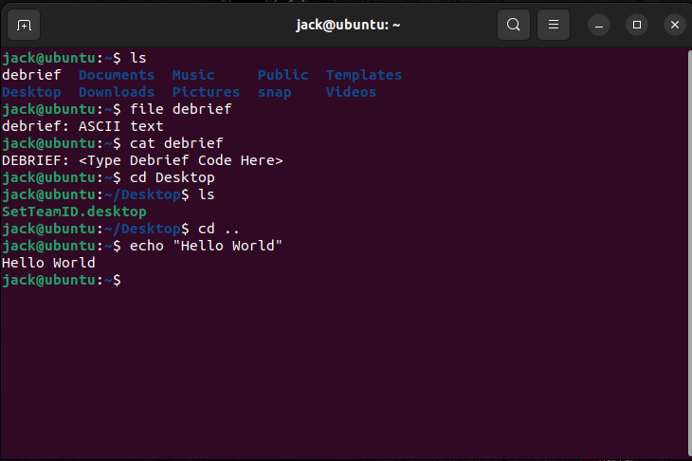
Command Line
A command line is a text-based interface which allows you to type commands and interact with the computer’s operating system. In Ubuntu, the command line is accessed through the Terminal. You can find it by searching the apps for “Terminal”.
You will learn about commands over the next few slides, but the picture on the right shows an example of what you can do in the Terminal. The dollar sign ($) indicates the start of a new command.

Slide 7
What is a Command?
A command is an instruction given to a computer to perform a certain task. There are numerous commands that can do numerous amounts of things. A certain syntax is used when executing commands to ensure they do what you want them to. You should always check that you are using the correct capitalization and spelling when typing in the Terminal.

Slide 8


Paths
Paths in Linux are slightly different from paths in Windows. Instead of folders, Linux calls them directories. Paths also use “/” instead of “\” as a separator. In Linux, you can either use absolute paths or relative paths.
Absolute Paths
Relative Paths
An absolute path starts at the root directory, which is the top-most directory in the system. It then lists out the rest of the directories and files from the root directory.
Ex: /home/User/Documents/foo.txt
A relative path starts at the current directory. The current directory is indicated by a single period (“.”). You can also access the parent directory (the directory that your current directory is in) by using two periods (“..”).
Ex: ./Documents/foo.txt

Slide 9
Basic Commands
Here are some basic navigation commands that you can use in the Terminal:
pwd: present working directory | Prints current directory
ls: list | List the directory’s contents (files and subdirectories)
cd: change directory | Navigates to a different directory
man: manual pages | View the manual pages of a command to see how it should be used
cat [FILE_NAME]: concatenate | Display contents of a file or create new file
file [FILE_NAME] | Determines the file type
echo [STRING] | Displays the string in the command line
[command] > [FILE_NAME] | Creates file with that file name or overwrites file if it already exists

Slide 10
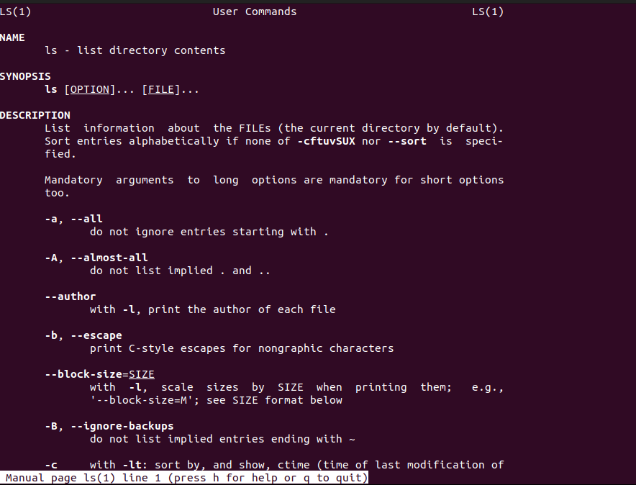
Command
Syntax
Manual page for the “ls” command:
When writing a command, you don’t always just put the basic command. Depending on the command, you might add flags (which modify the behavior of the command) or a path to a file or directory.
For example: “ls” does not list files starting with a period but using “ls –a” will list those that start with a period.
To see how to structure a certain command and what flags can be used, you can open the man page for that command by typing “man” and then the command.
Tip: research the “alias” command! It isn’t required but may be useful during the competition!

Slide 11
System Updates

Slide 12
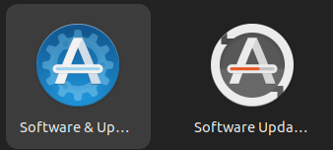
Installing System Updates
System updates are slightly different to do on Linux than on Windows. Linux has two applications: Software & Updates and Software Updater. Software & Updates contains settings for your software or regarding updates. Software Updater simply checks for updates and allows you to install them.

Slide 13
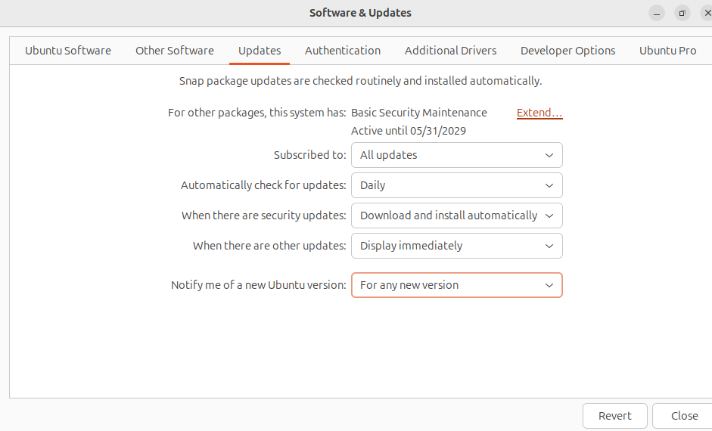
Using Software & Updates
Once you open the Software & Updates application, there are several tabs of settings that you can explore. Right now, we are only focused on the “Updates” tab. Under this tab, you are able to configure how often you want the system to check for updates, along with notification settings about security and other updates.

Slide 14
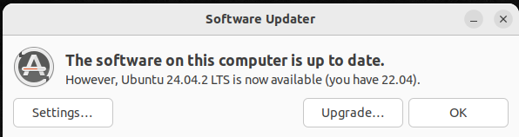
Using Software Updater
Simply open Software Updater, and it will automatically check if there is an update available. If there is an update available, you can hit the “Upgrade” button, which will bring you to a few pop-ups where you will have to agree and continue to update. You can also click “Settings”, which will take you to the Software & Updates application
This is what you will see if there is an update available.
Note: you can also update software through the Command Line, but this will be taught in a later lesson!

Slide 15
Activity!
Getting Started
Objectives
Students will be able to test their knowledge of the command line. Topics discussed will be in reference to:
Command Line
Paths
Basic Commands
Command Syntax
1.) Open your OKCup Linux VM and get ready to practice those skills you just read up on!
2.) Use the PowerPoint slides for specifics on how to achieve goals
3.) Take plenty of notes/screenshots so that for the competition, you have some quick references!

Slide 16
Instructions
Open the Command Line. You will be given a series of tasks to complete on the next slide that will help you get more familiar with using the Command Line. Each task has a hint that you can use if needed.
*Tip: Use Ctrl + Alt + T as a shortcut to open up the Terminal!

Slide 17

Tasks
What directory are you starting in?
List all files/folders in that directory. What do you see?
Navigate to one of the folders in the directory.
Read one of the text files.
Open the manual page for any command.
Add your name to a new file called student.txt.
Hint for Task 1
Use pwd
Use ls
Use cd
Use cat
Use man
Use echo “YourName” > student.txt
Hint for Task 2
Hint for Task 3
Hint for Task 4
Hint for Task 5
Hint for Task 6

Slide 18
QUIZ!
Test your knowledge! Remember your answers so you can check them at the end!

Slide 19



Question 1
Which of the following is a Linux distribution?
Blue Hat
MacOS
Ubuntu

Slide 20
Question 2
You should always check that you are using the correct ______ and spelling when typing in the Terminal.
Color scheme
Capitalization
Font

Slide 21
Question 3
Which directory does an absolute path start from?
Parent directory
Root directory
Current directory

Slide 22
Question 4
What character symbolizes the current directory?
“..”
“.”
“/”

Slide 23
Question 5
What do flags do in a command?
They modify the behavior of the command
They change the language of the command
They rename the command

Slide 24
Question 6
What application do you use for installing software updates?
Software Updater
Google
Start Menu

Slide 25


Quiz Answers
Question 1
Ubuntu is a Linux distribution, along with Red Hat, Mint, and Fedora.
Question 2
You should always check that you are using the correct capitalization and spelling when typing in the Terminal.
Question 3
An absolute path starts from the root directory.

Slide 26
Quiz Answers
Question 4
A single period, “.”, symbolizes the current directory.
Question 5
Flags modify the behavior of the command.
Question 6
You use Software Updater to install software updates.

Slide 27

More Resources
If you would like to do further research on operating systems, here are a few good resources:
01
https://linuxsurvival.com/ - This is a good website for learning Linux commands and operations. Test out some of the commands you learned!
02
https://overthewire.org/wargames/ - This is a fun game to learn using commands in the Terminal.
03
https://linuxjourney.com/ - An interactive website for learning more about Linux!

Slide 28



THANK
YOU!

